Slide 1


Kadi Sarva Vishwavidyalaya
B.P College of Computer Studies – BCA
S.V College of Computer Studies – BCA
BCA SEMESTER – VI
BCA – 605
PROJECT PHASE – II
AUTOMOBILE HUB
Name | Exam no. | Enrollment No.
Chauhan Bhagatsingh |  | 20BCA53045
Khant Rahulbhai |  | 20BCA53015
Patel Shanikumar |  | 20BCA04194

Slide 2
Project Title:-
AUTOMOBILE HUB
Project Definition:-
Our project is meant to give people a better and trustworthy platform where they can sell and buy cars of their own choice and obviously on their own terms and condition. With the help of internet and computer systems a man from remote area can buy/sell his car from anywhere the country/world. Through this system if any enquiry occurs it is corresponding entries is done automatically because database management system gives facility of having relationship between the tables. In proposed system we do not have to maintain record manually.

Slide 3
Scope of Project: -
The main goal of this project is designing and developing an interactive Car SalesSystem.
These details are routinely maintained depending on the numerous inputs and thechanges made in the systems database.
The alterations in the database can happen spontaneously,for example, after the system performs calculations on the direct inputs.
This system essentiallyworks on input-output entry mechanism.
The Car Sales System follows closely with otherdeveloped Information Systems focusing on achieving better transactions and more customersatisfaction

Slide 4
Goals Objective of Project : -
Easy to generate report for any transaction.
It is very much faster than manual system.
Easy and fastest record finding technique.
It is very much flexible to work
Man power required is very less.
Data can be stored for a longer record

Slide 5
Technology used for Project: -
Front-end languages:
php
Back-end languages: - MySQL

Slide 6
Study of Existing System:- (CARS24)
In the existing system, the registered users and unregistered users can buy/sell use cars with some searching criteria like color, company.
In this system, if the visitors can visit the website once then message will not be going in their mobile/email by the existing system.
The existing system is paid and in this system commission is taken for buying/selling used cars.

Slide 7
ADVANTAGES OF EXISTING SYSTEM :-
1. Free Warranty ·
2. Zero Down payment, Quick Financing ·
3. Top Possible Quality ·
4. Seven Day Easy Return ·
5.Buy Online, Free Home Delivery.

Slide 8
DISADVANTAGES OF EXISTING SYSTEM :-
Old - How much ever advantage or benefit you get from buying a used car, in the end, the car is old. It has already been used by someone and you have to drive with it. The design, features and gadgets will also be old.
Maintenance - While you will be saving on lesser down payment and insurance costs, a used car comes with years of wear and tear in its parts and thousands of kilometers in its odo. That equals more time and money for maintenance. The accidents the car has been in and the scratches and dents are added bonus.

Slide 9
Operational Level Problems:-
Cyber Risks
incompatible browser blocking the use of WEB
Monitoring Performance
User-Related Issues
Technical Level Problems:-
Data Security
Payment Gateway accuracy
Server Compatibility

Slide 10
Informational Level Problems:-
Identification of users (user information)
User don’t understand the features
Sometime payment procedure have the error

Slide 11
Proposed system: -
The aim of proposed system is to develop a system improved facilities.
The proposed system can overcome all the limitation of existing
other system(CARS24).
The system provides proper quality, system with extreme functionalities and save the time.

Slide 12
PROPOSED SYSTEM ADVANTAGES:-
Easy to generate report for any transaction.
It is very much faster than manual system.
Easy and fastest record finding technique.
It is very much flexible to work.
Man power required is very less.
Data can be stored for a longer period.
PROPOSED SYSTEM DISADVANTAGES:-
The user cannot view the vehicle in person.
No human interaction.
If poor quality photographs are uploaded, system proves inefficient..

Slide 13
Proposed System Modules:-
There are two main modules in proposed system:
Administrator Module
User Module
1) Administrator Module:-
Log in setting:
Administrator can do log in setting Outgoing server configuration.
Edit contact details Setting:
Once you have logged in as Administrator role. Go to the pages and change the details.

Slide 14
Change user name password :
For the change user name or password just go to my profile and you can change it.
Edit car detail and company details :
Once you log in as admin role. On admin home page you can see the edit option for the car and company.

Slide 15
2) User Module:-
user can view the website and checkout the information about cars and they can also enquiry about the car.

Slide 16
System requirement specification(SRS) including:-
User side:-
Hardware:-
mobile/tablet 2. laptop 3.computer
Software:-
1.browser 2. internet connection
Admin side:-
Hardware:-
Processor: Pentium-iv and above
RAM: 256 MB
Hard Disk: 4.3GB
Floppy Disk: 1.44 MB
CD Drive
Monitor-15” Color Monitor
Software:-
OS : Windows XP
PHP Triad (PHP, MySQL, Apache, and PHPMyAdmin)

Slide 17
Functional Requirement:-
Welcome Screen:
In this screen we provide some best cars.
Home page :
Home
About us
Cars
Companies
Contact us
Admin
That options are available in home page customer.

Slide 18
Non-Functional Requirement:-
Maintainability:
A commercial database is used for maintaining the database and server takes care of the site . Which is MySQL.
Security:
Mandatory Login and Sign up Enable/Disable option is available in the system so can provide security to the system.

Slide 19
Feasibility Study of Proposed System: -
The objective of feasibility study is to determine whether or not the proposed system is feasible. The feasibility is determined in terms of four aspects. These are:
Operational Feasibility
Technical Feasibility
Economical Feasibility
Scheduled Feasibility

Slide 20
Operational Feasibility:-
The system requirements of the users and the administrator we can say the system is operationally feasible.
The system will improve the total performance
The system will provide a better platform for different user categories.

Slide 21
Technical Feasibility:-
Technology exists to develop a system.
The system is capable of holding data to be used.
The system is completely liable with proper security.
The system being modular to the administrator.
Economic Feasibility:-
Easy and cheap maintenance of the system possible.
The cost of hardware and software is affordable.
It can be easily developed in friendly atmosphere of desktop

Slide 22
Scheduled Feasibility

Slide 23
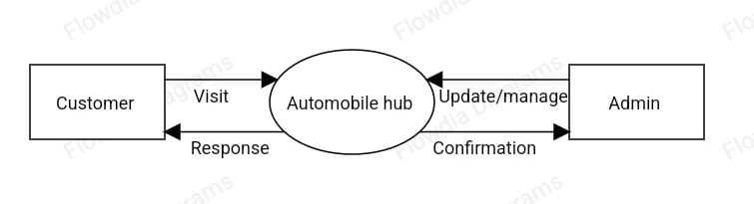
0 Level DFD
0

Slide 24
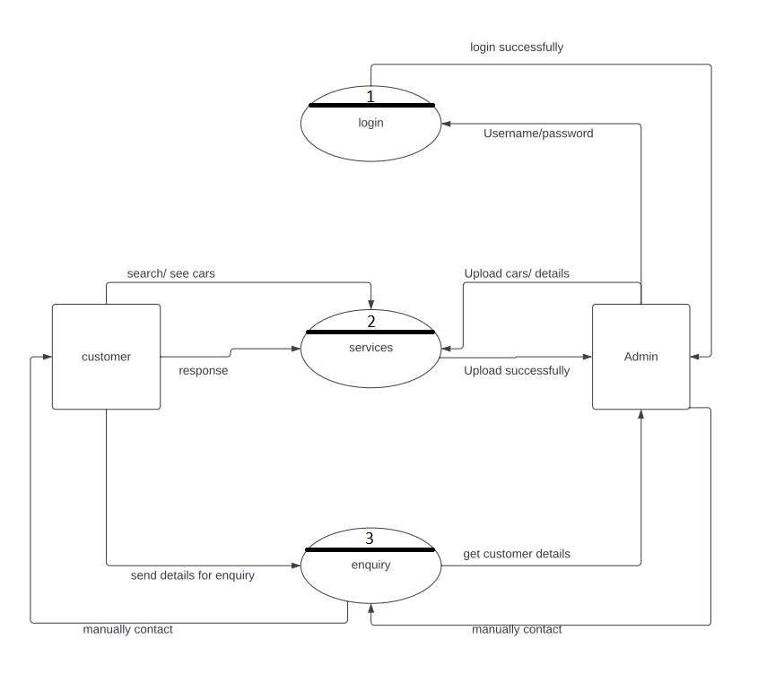
1-level dfd

Slide 25
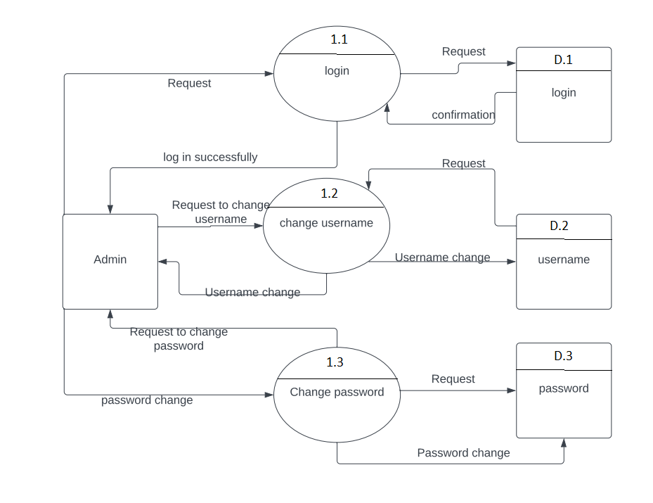
2 Level DFD

Slide 26
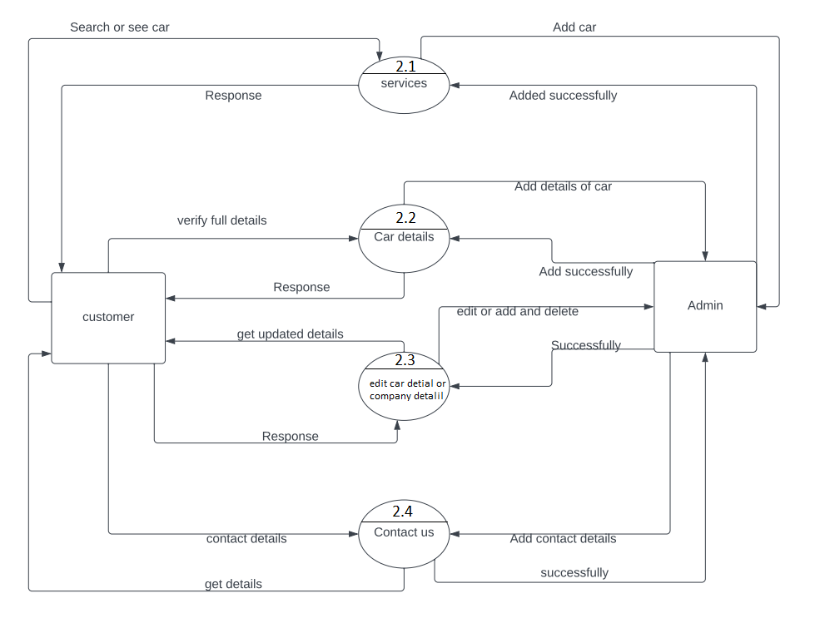
2 Level DFD

Slide 27
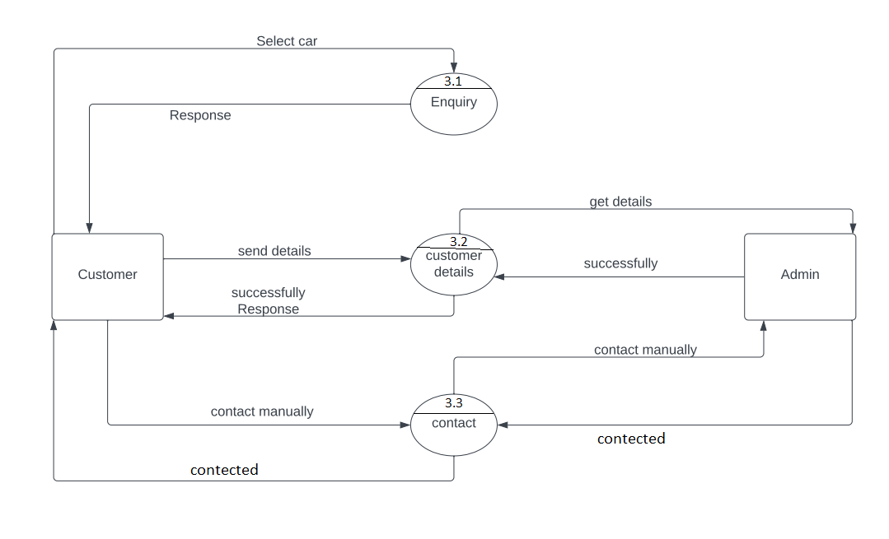


2 Level DFD

Slide 28
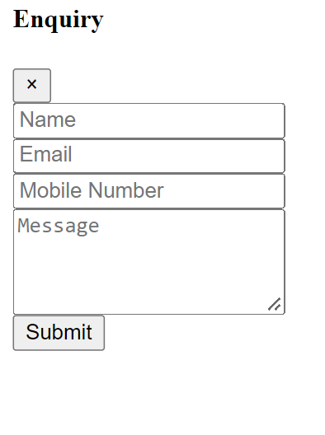
Screen layout

Slide 29
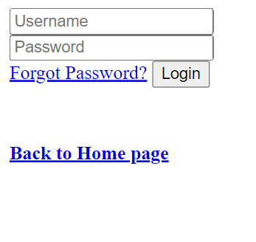
Admin log in

Slide 30
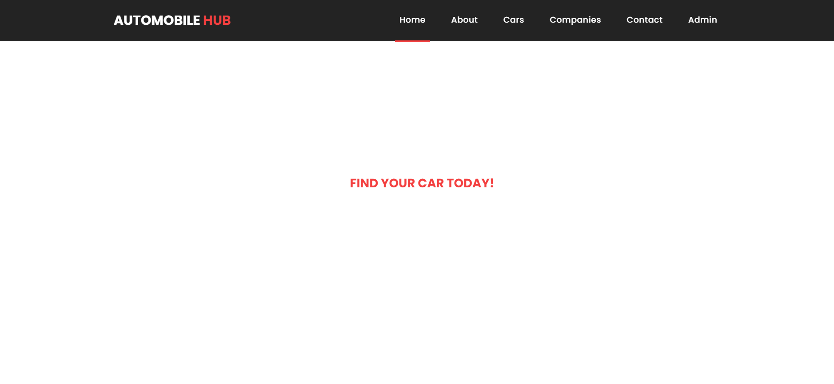
Home screen

Slide 31
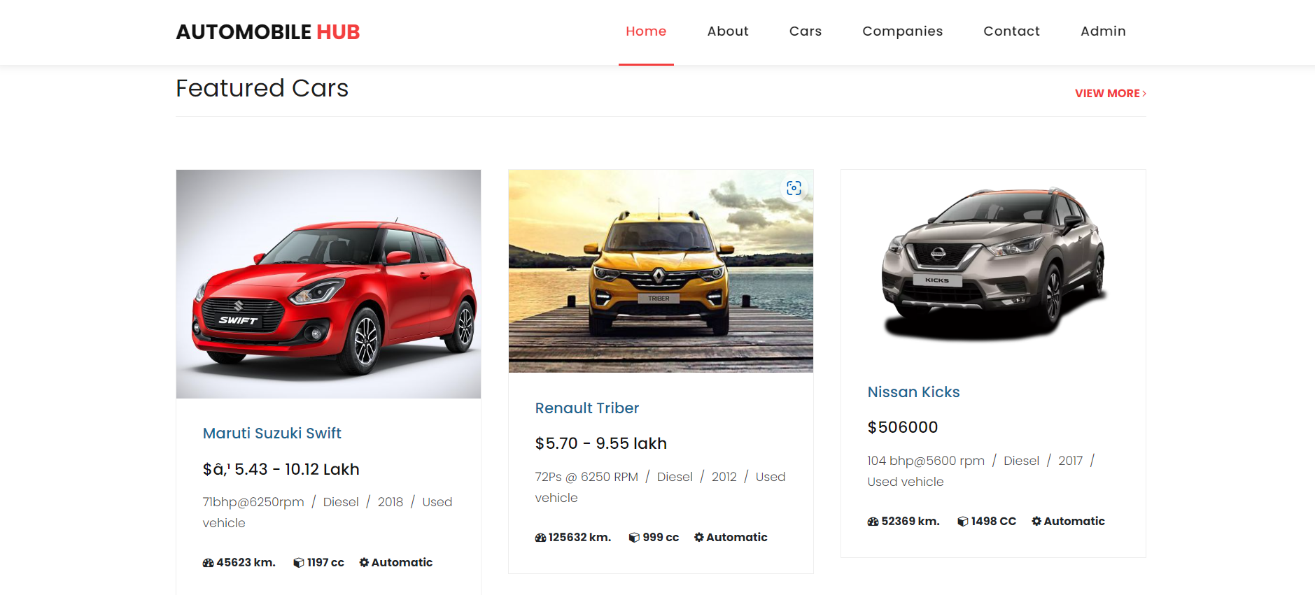
Home screen

Slide 32
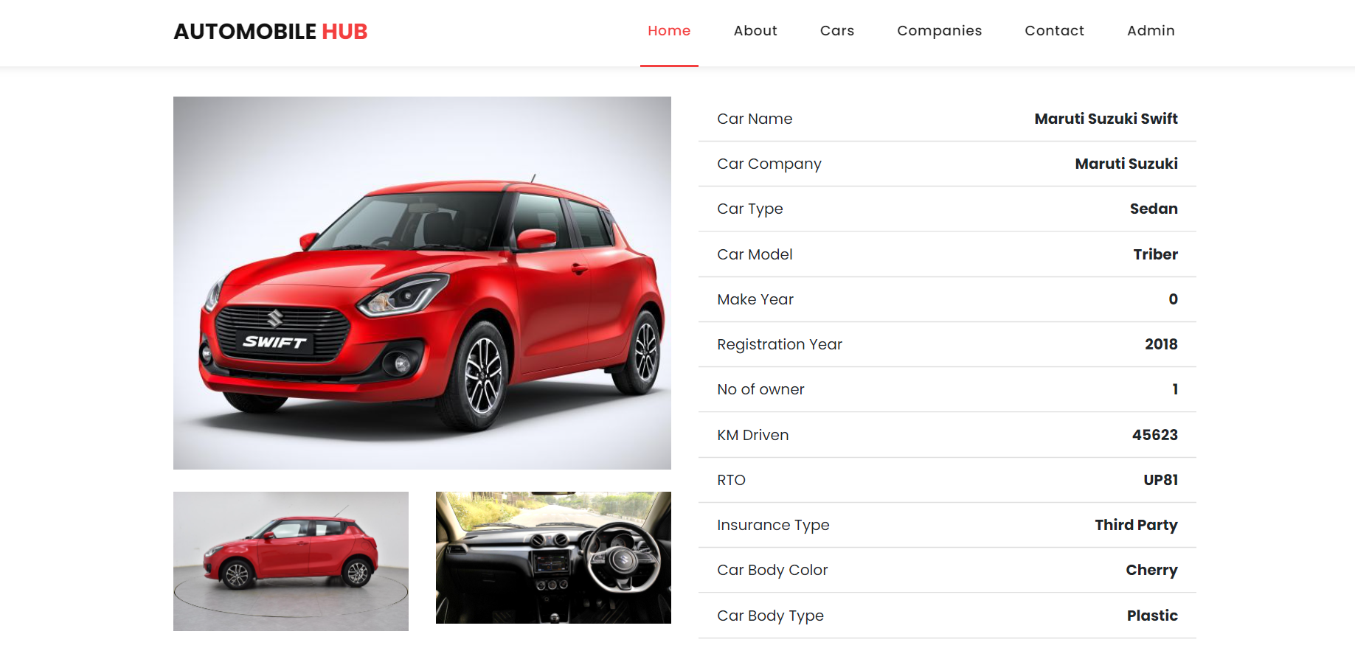
Car details

Slide 33
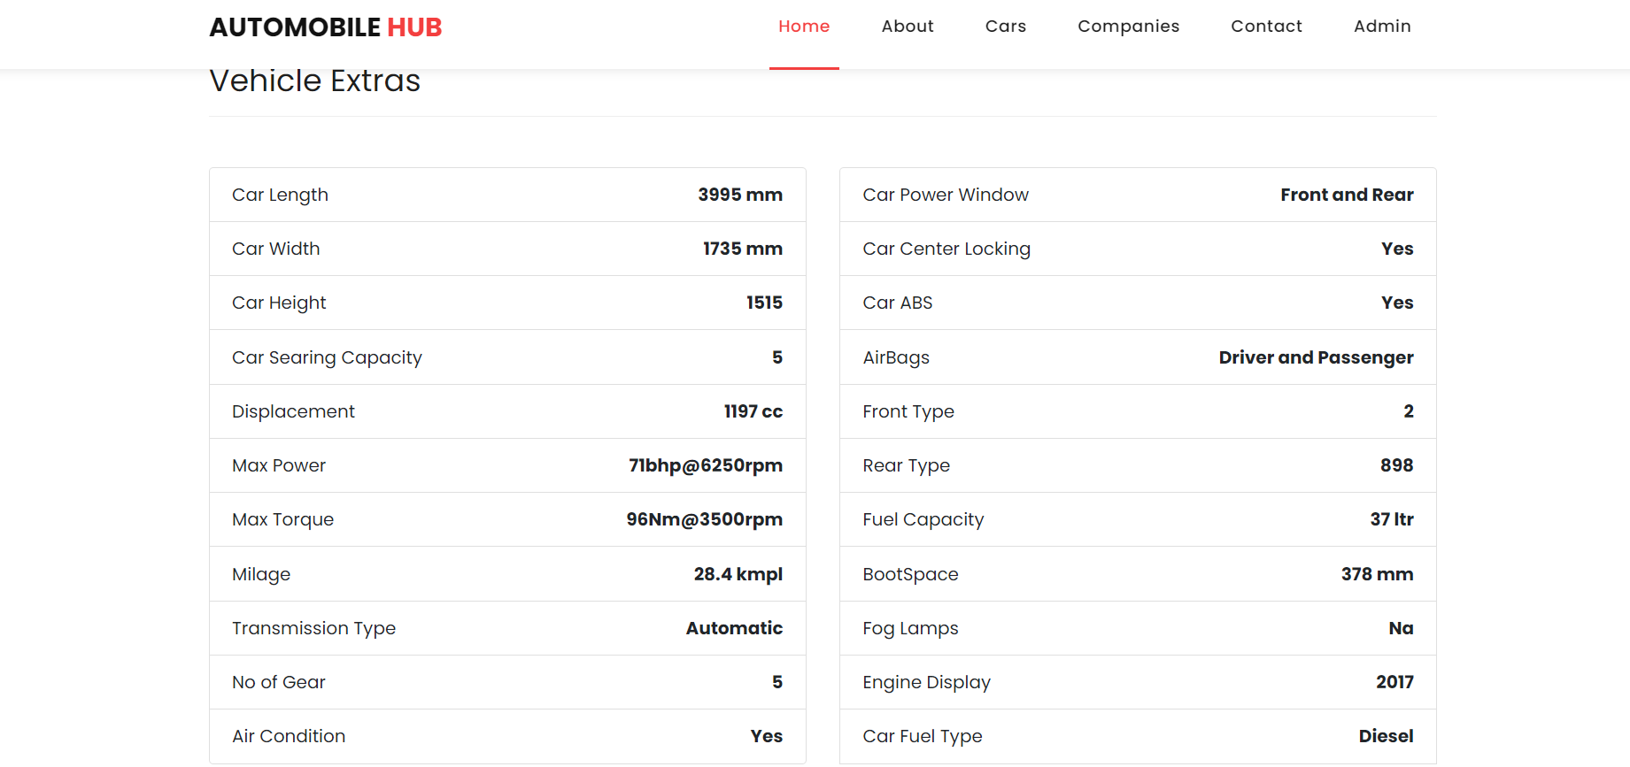
Car details

Slide 34
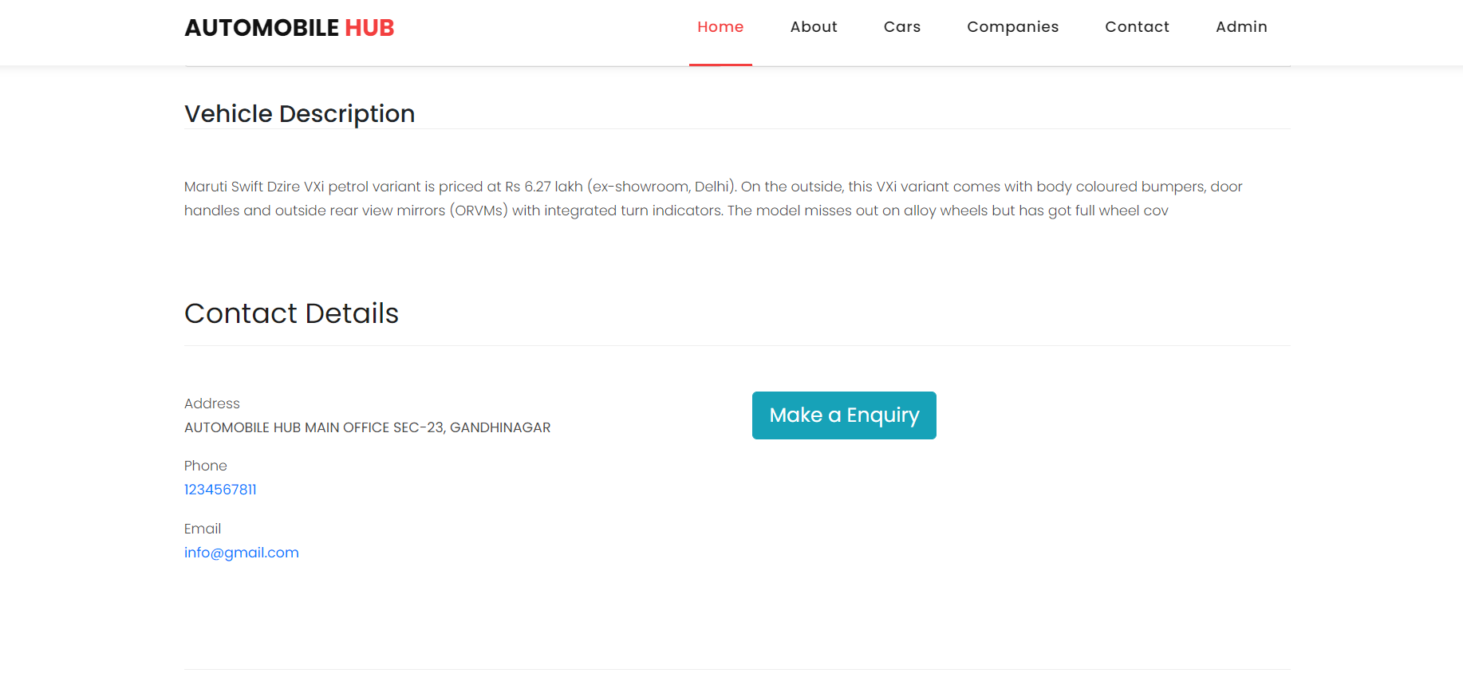
Our contact details in evry car detail

Slide 35
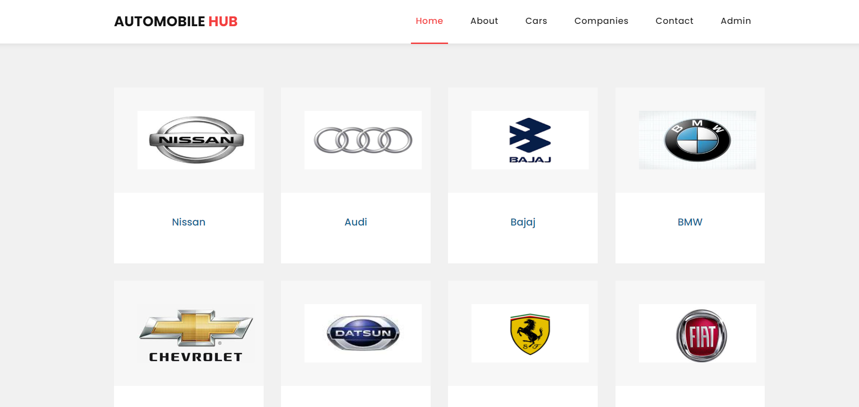
Car companies page

Slide 36
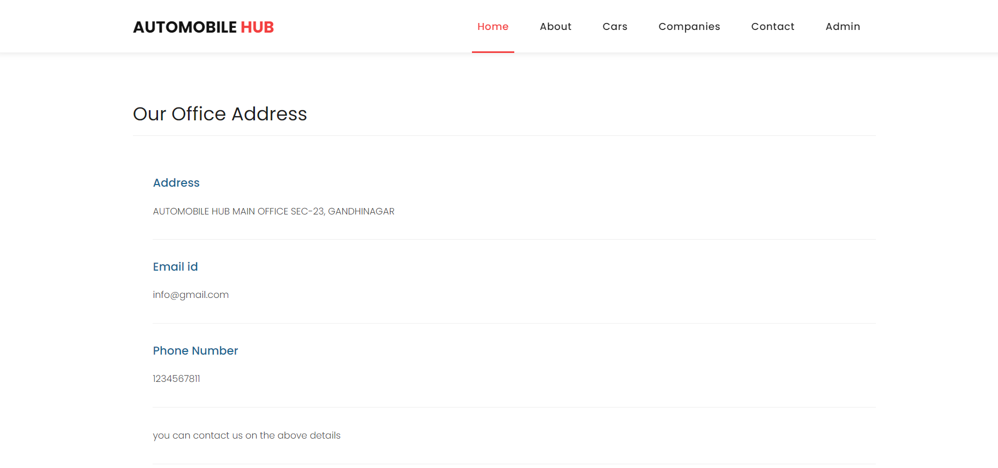
Contact us page

Slide 37
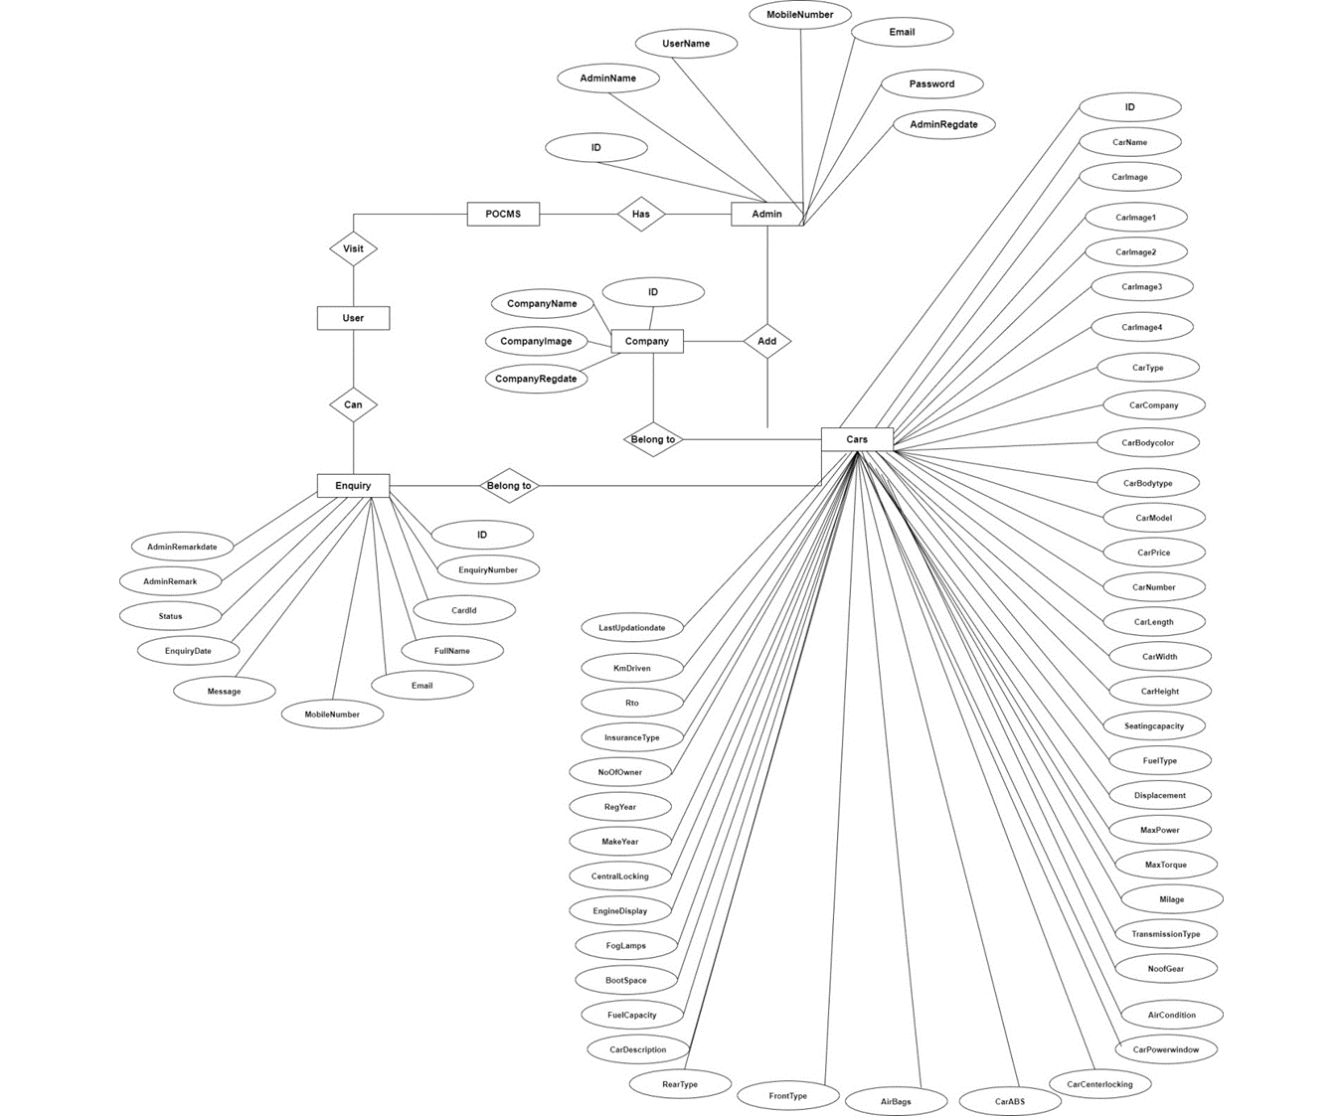
E-R Diagram

Slide 38
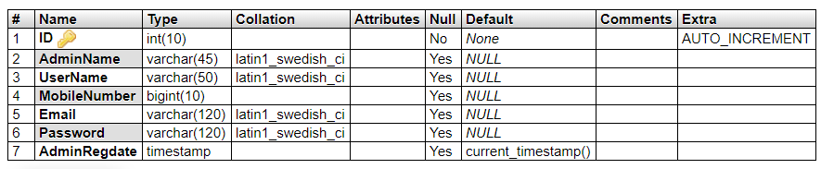
Data Dictionary :
This table store the login details of admin.

Slide 39
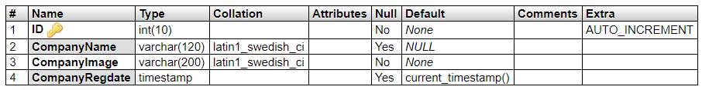
This table store car company info.

Slide 40
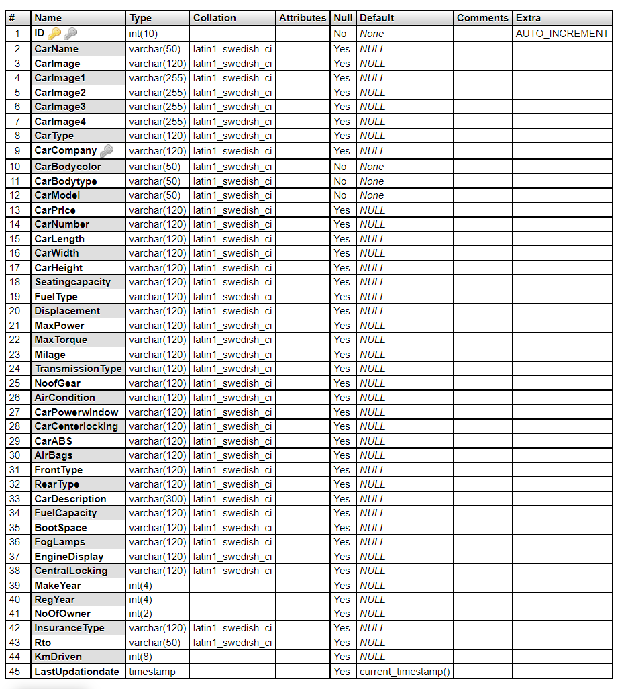
This table store full car details.

Slide 41
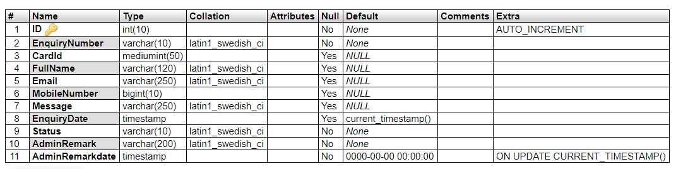
This table store car enquiry details.

Slide 42
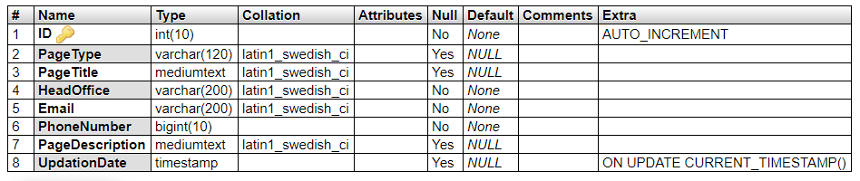
This table store car pages details.

Slide 43
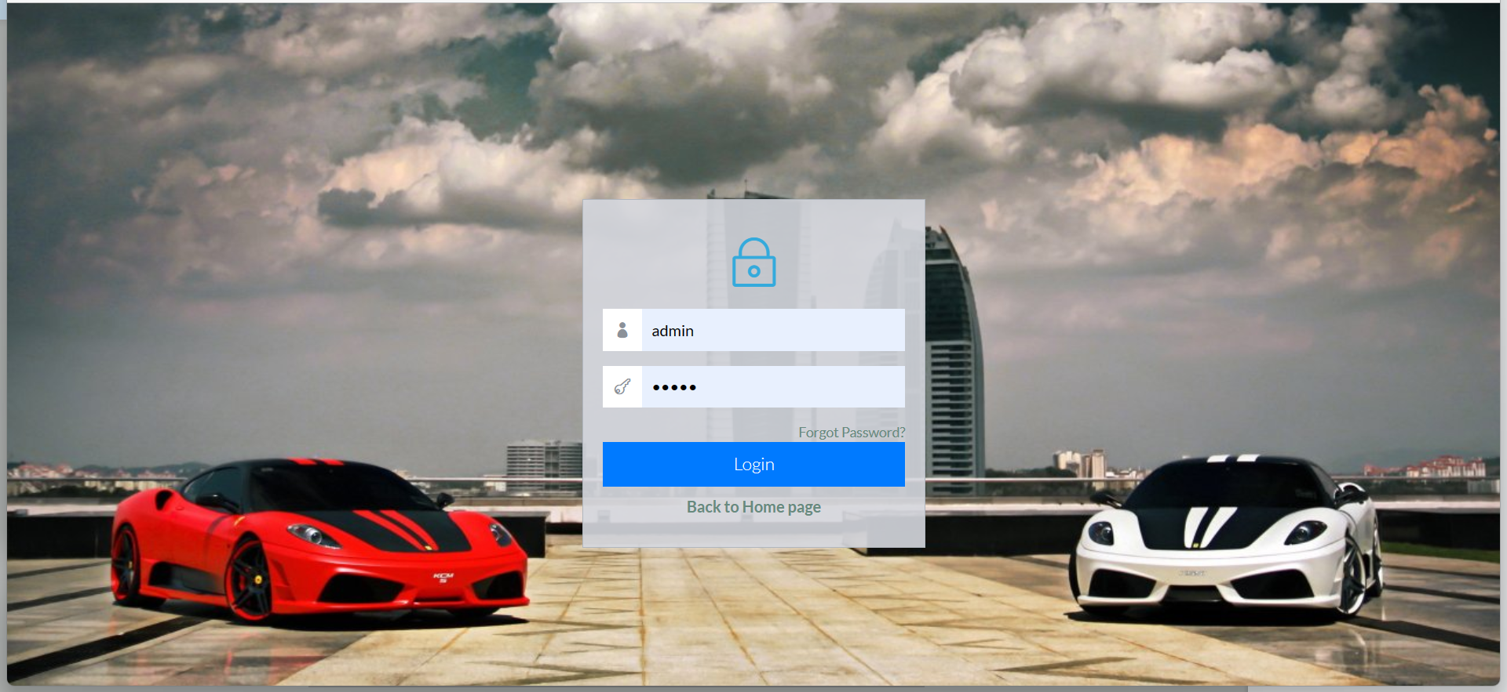
7.SYSTEM IMPLEMENTATION AND DESIGN SYSTEMDESIGNS OFAUTHENTICATION:SIGNUP&LOGINFORM Admin log in form:

Slide 44
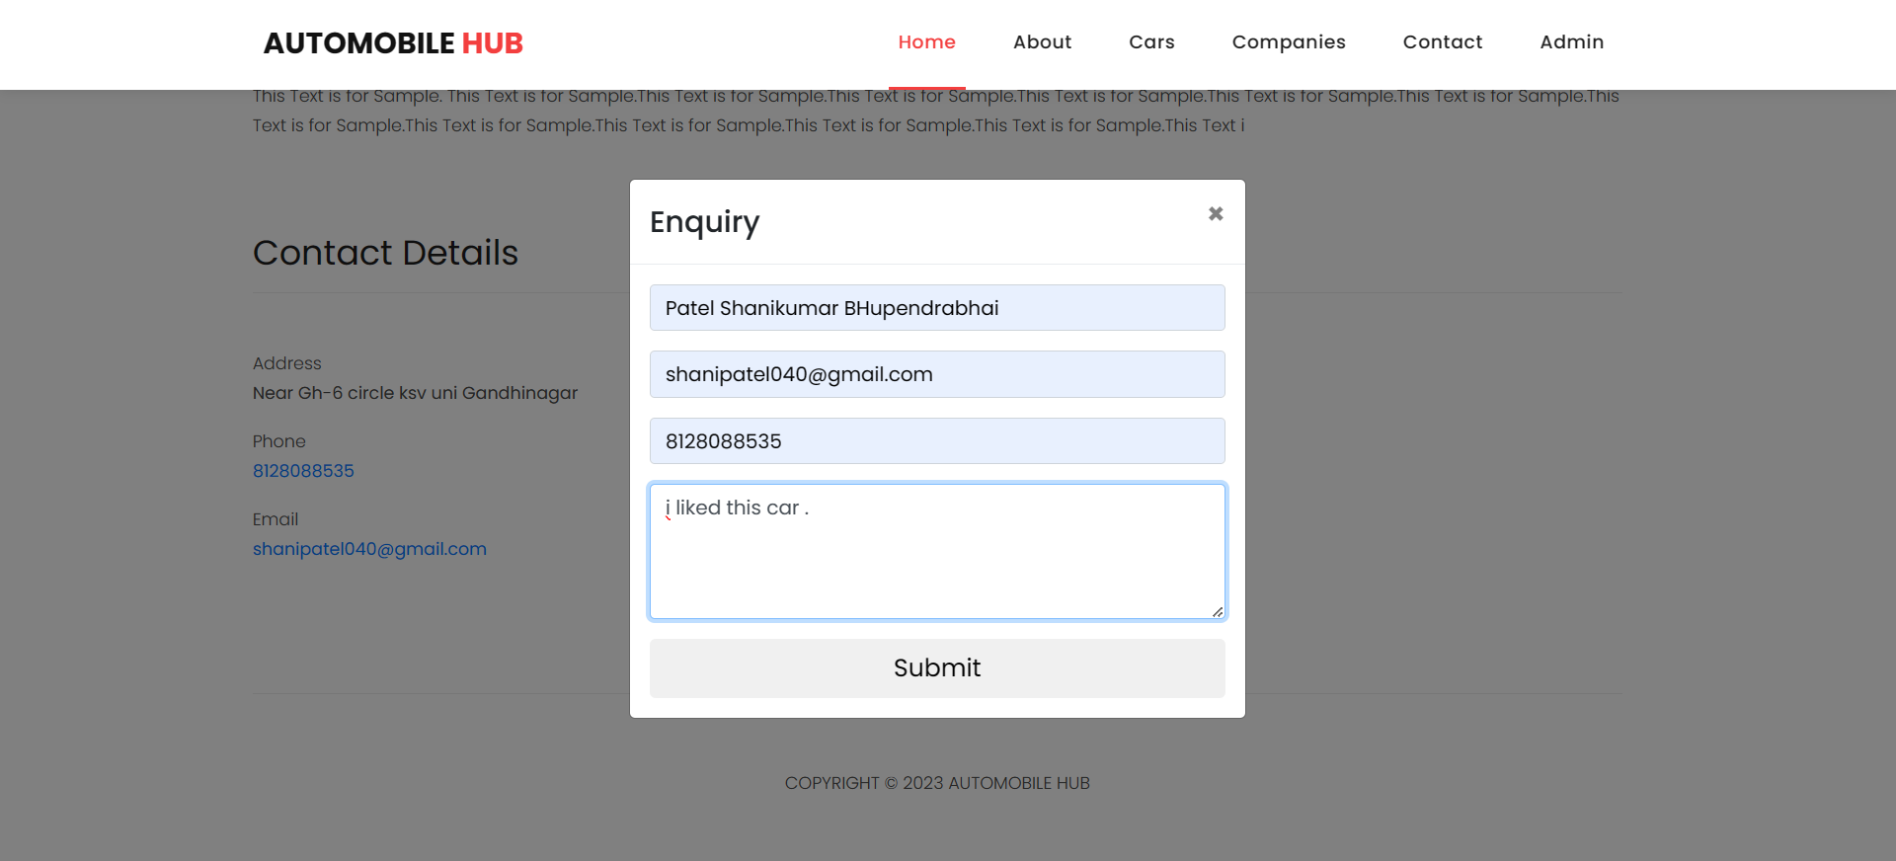
Enquiry form:

Slide 45
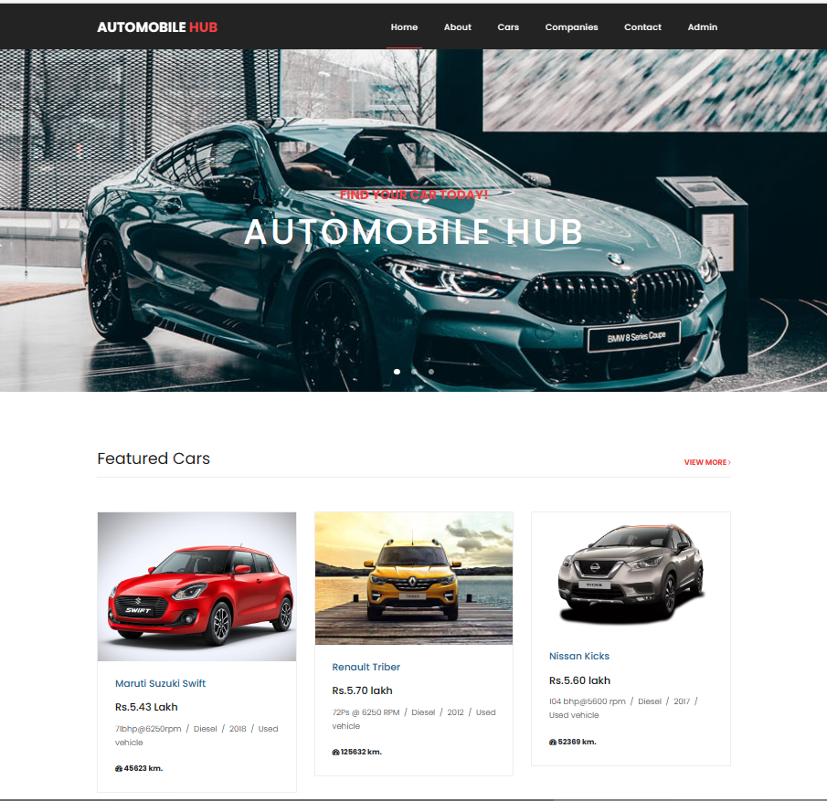
SYSTEM ADMINISTRATION DESIGNS: TRANSACTIONS, SEARCHING Home page:

Slide 46

About us:

Slide 47
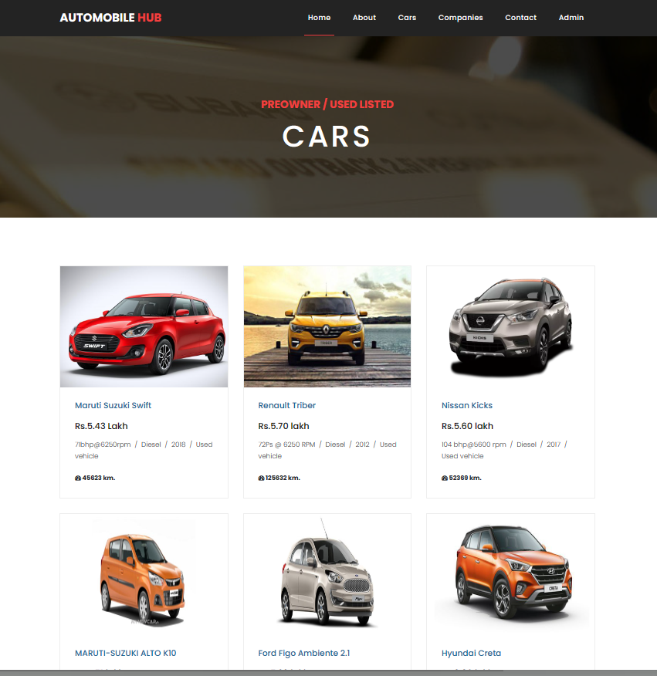
Cars:

Slide 48
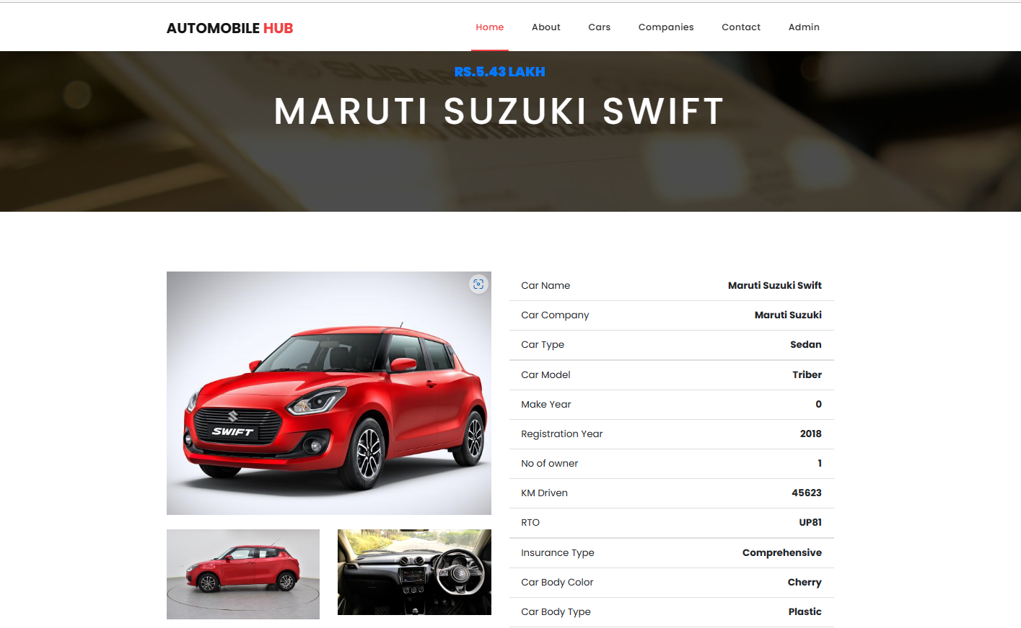
Car details:

Slide 49
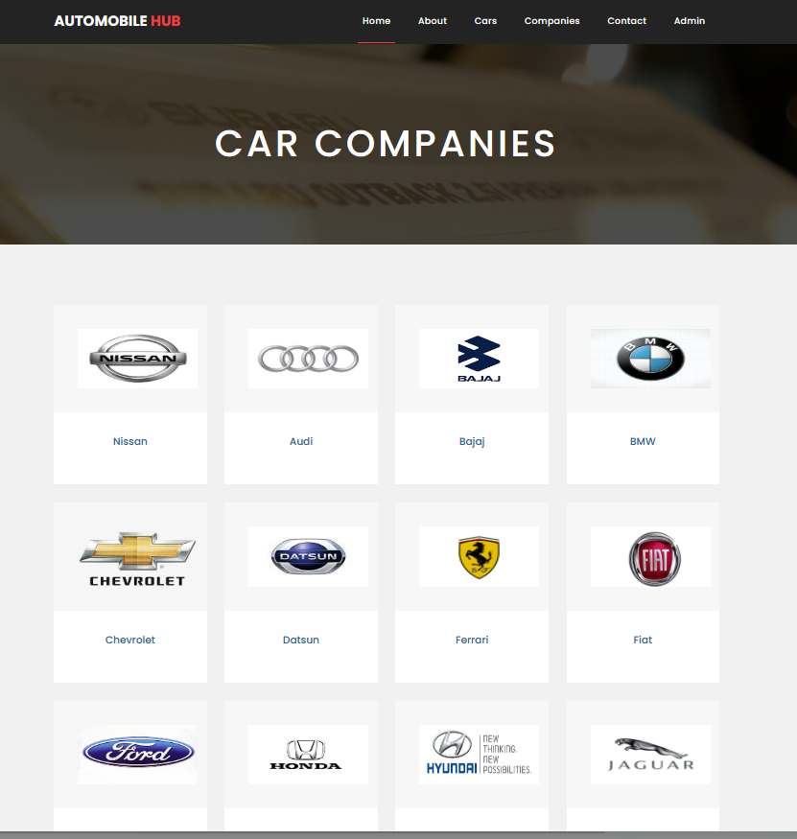
Car Companies:

Slide 50
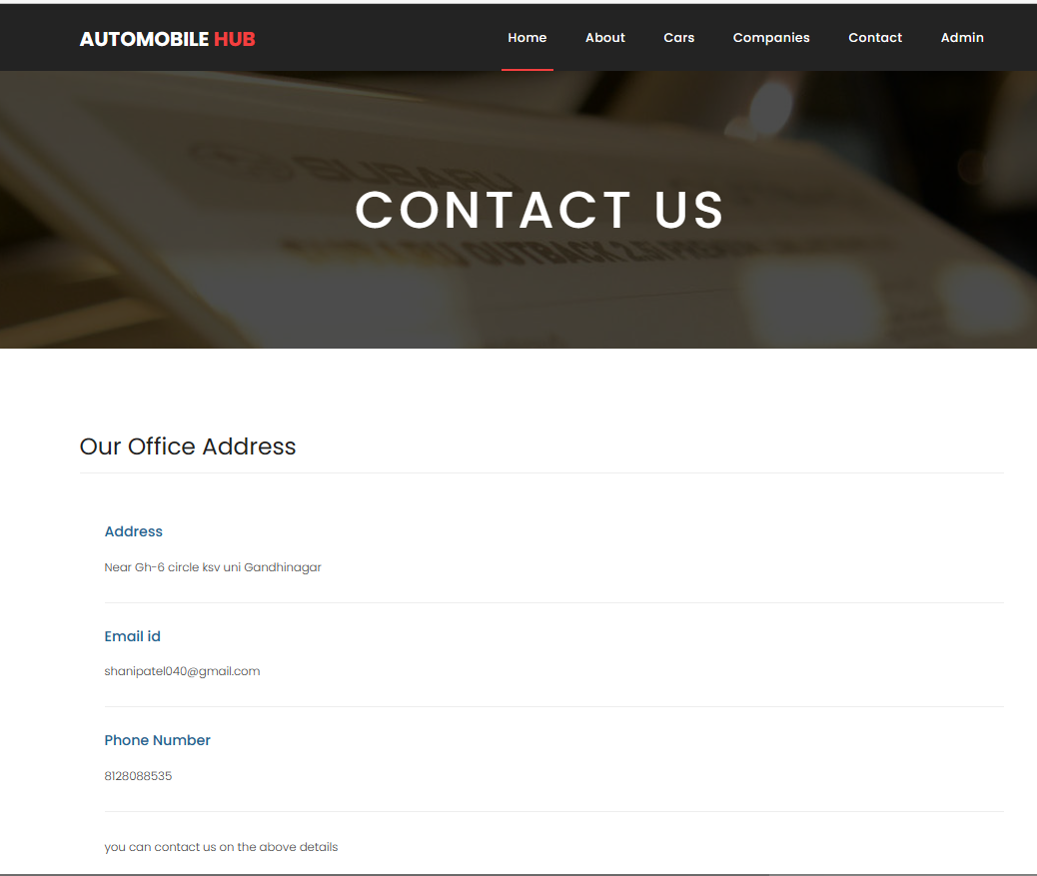
Contact us:

Slide 51
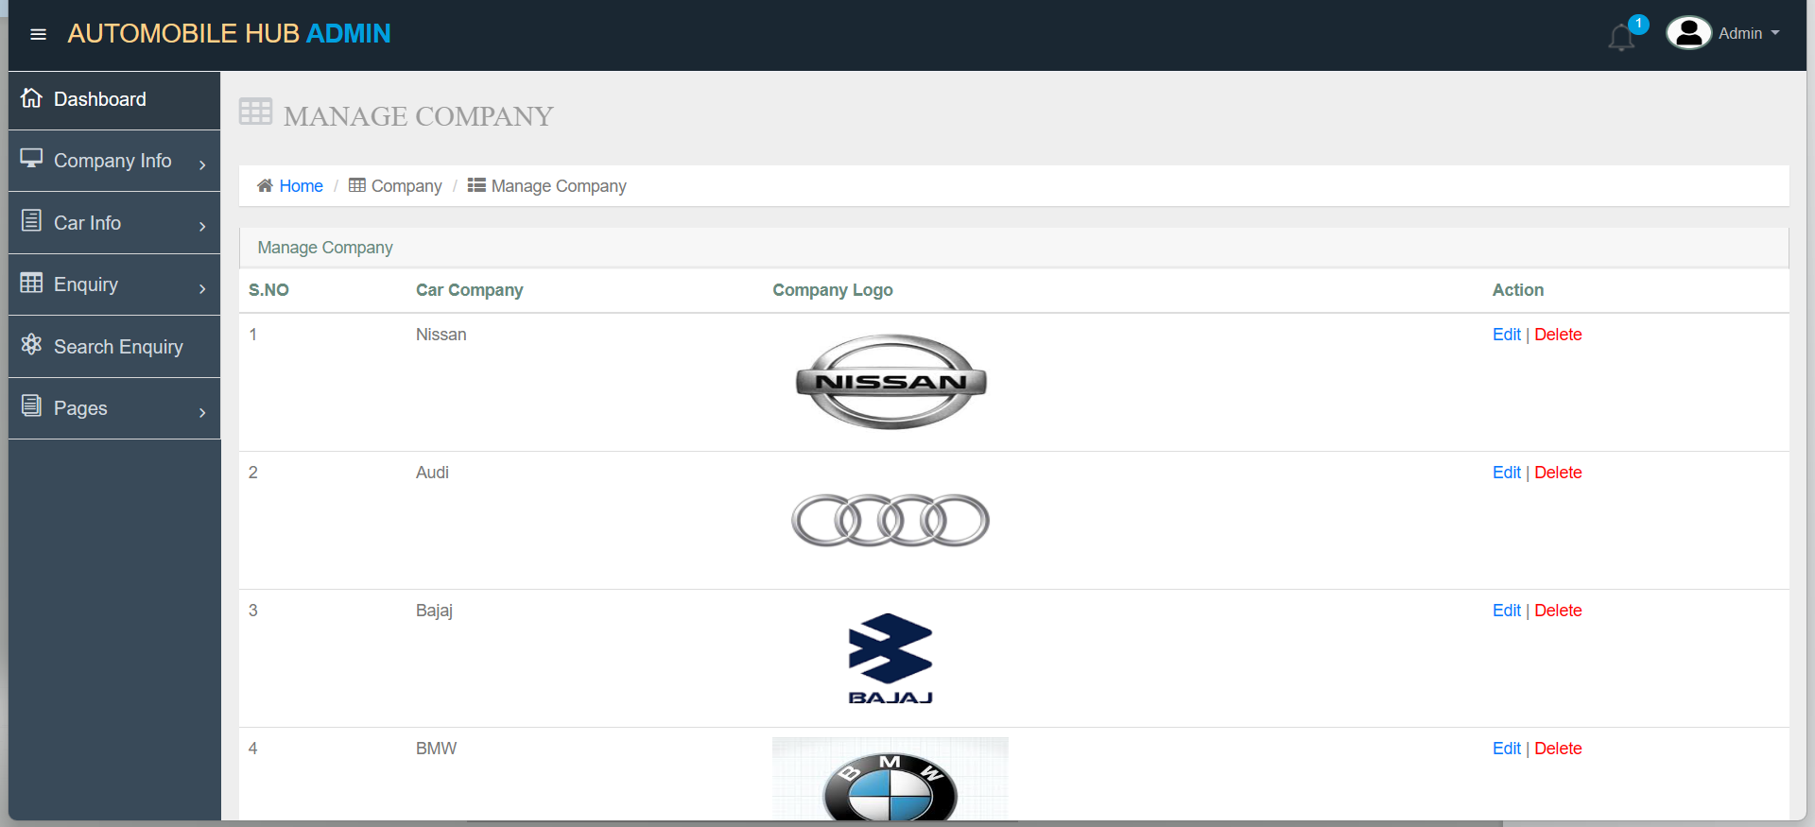
Manage company(admin):

Slide 52
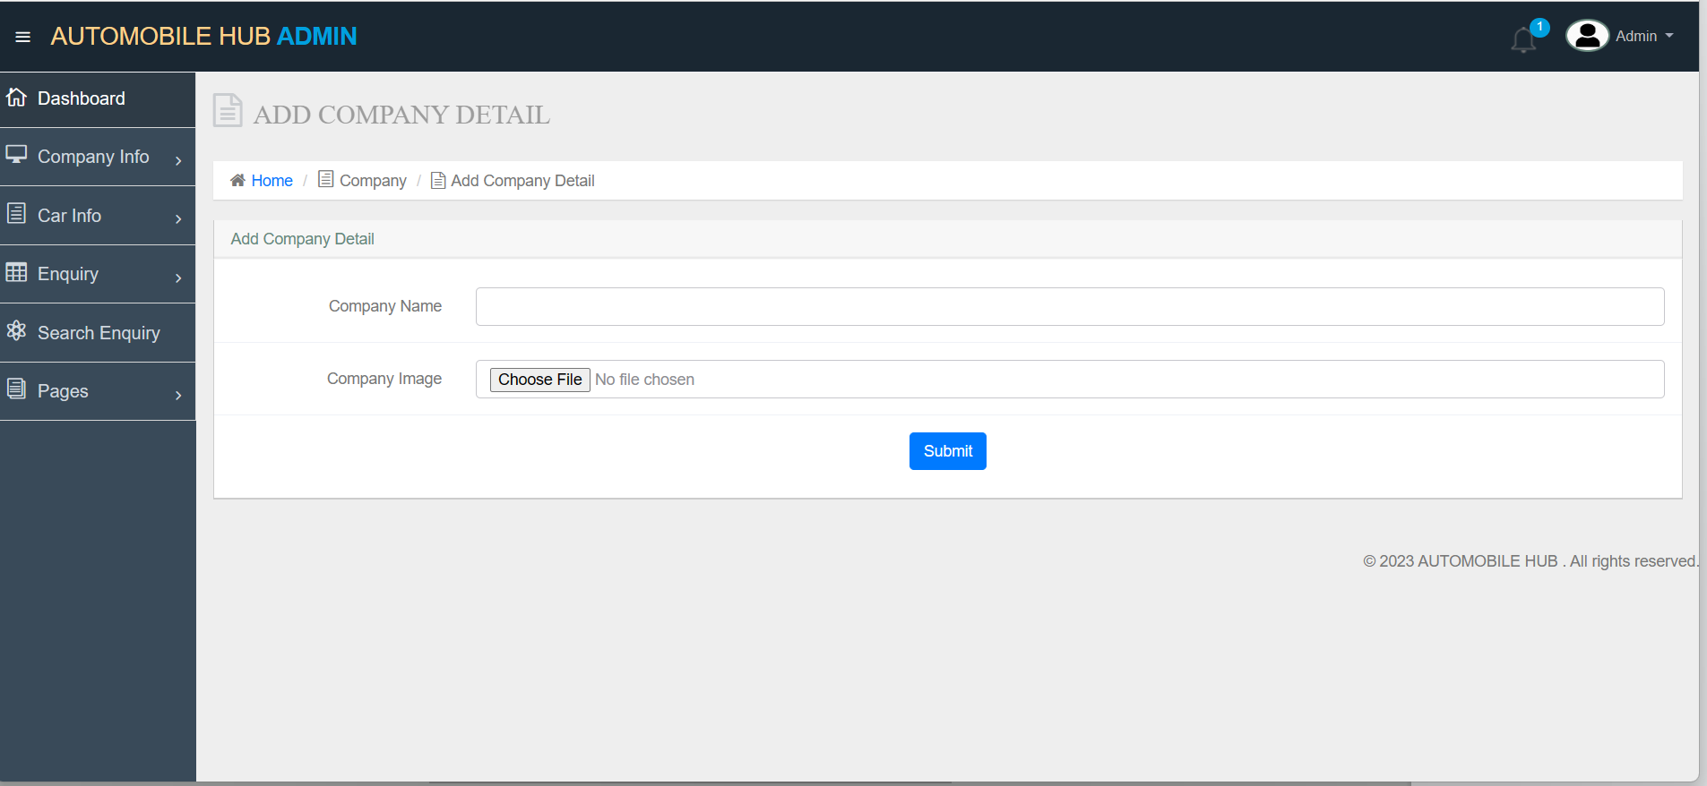
Add company detail(admin)

Slide 53
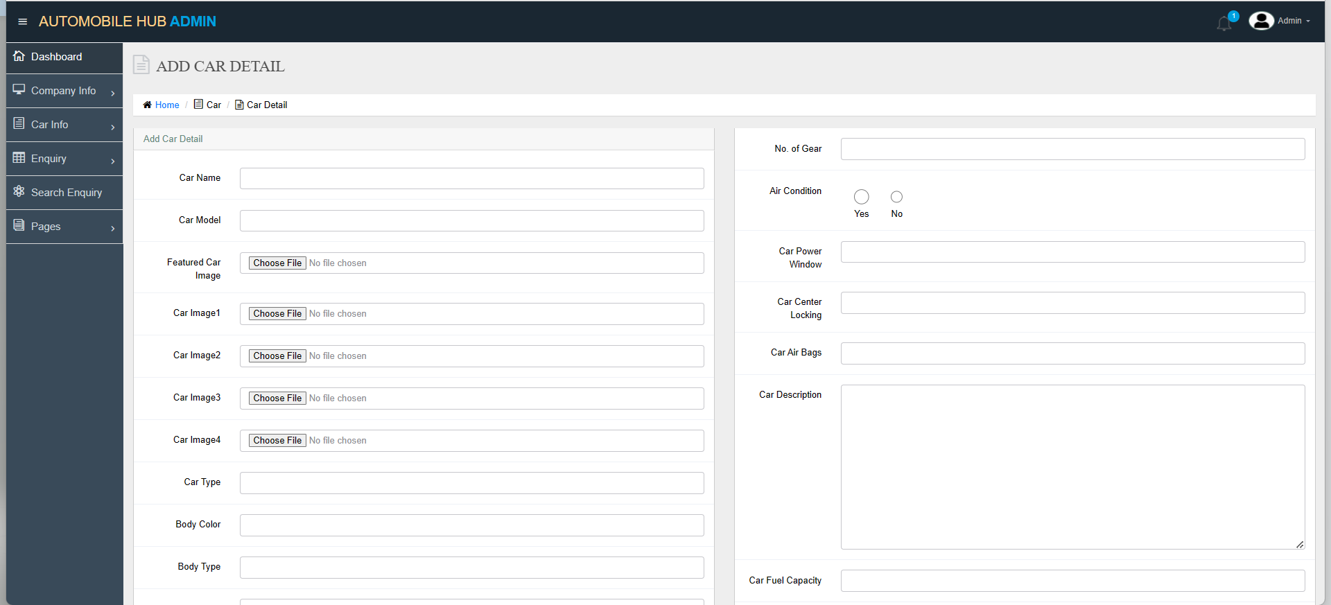
Add car detail(admin):

Slide 54
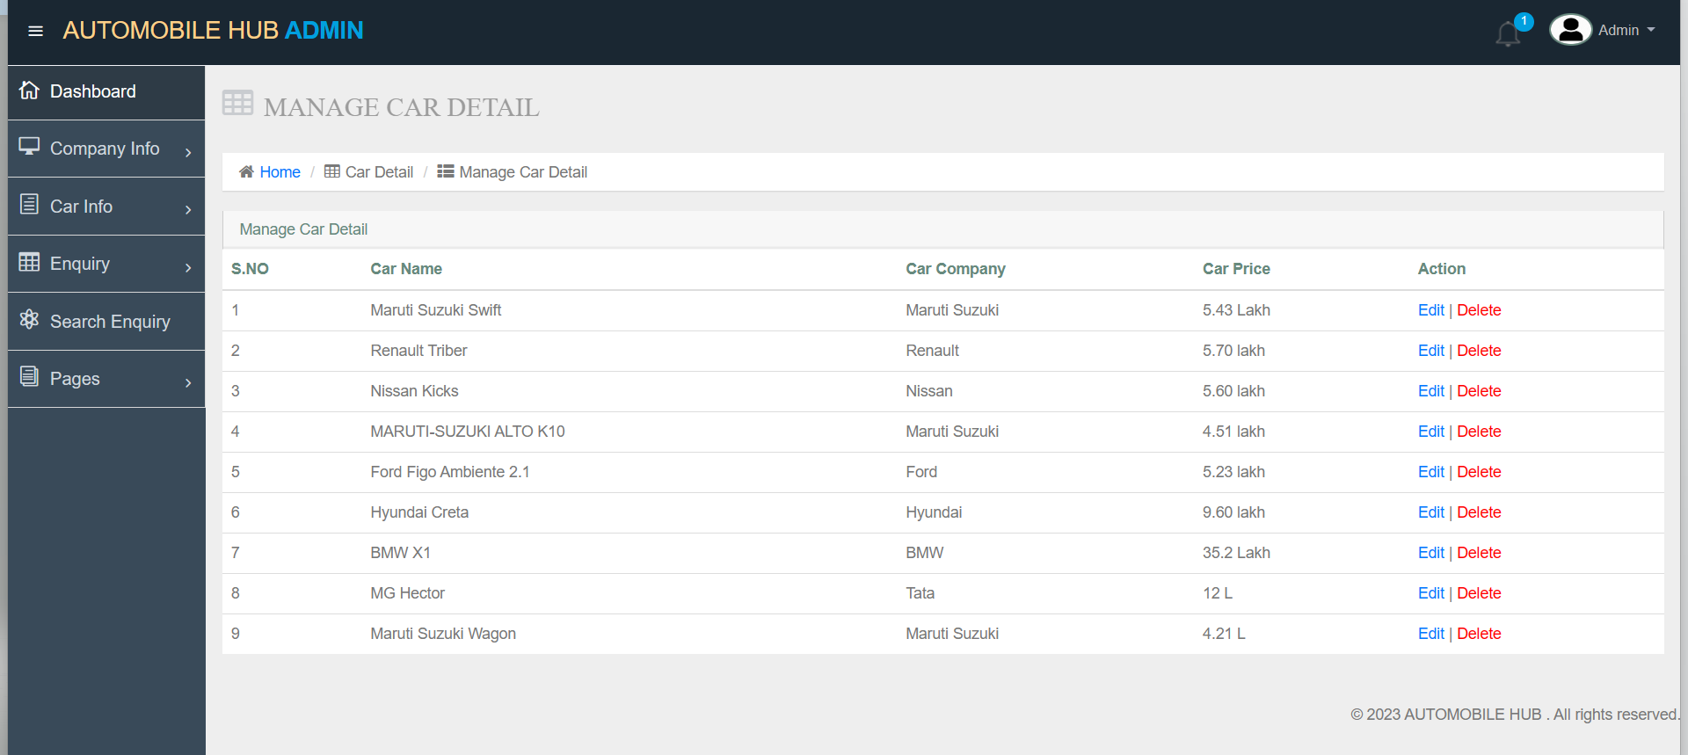
Manage car detail(admin):

Slide 55
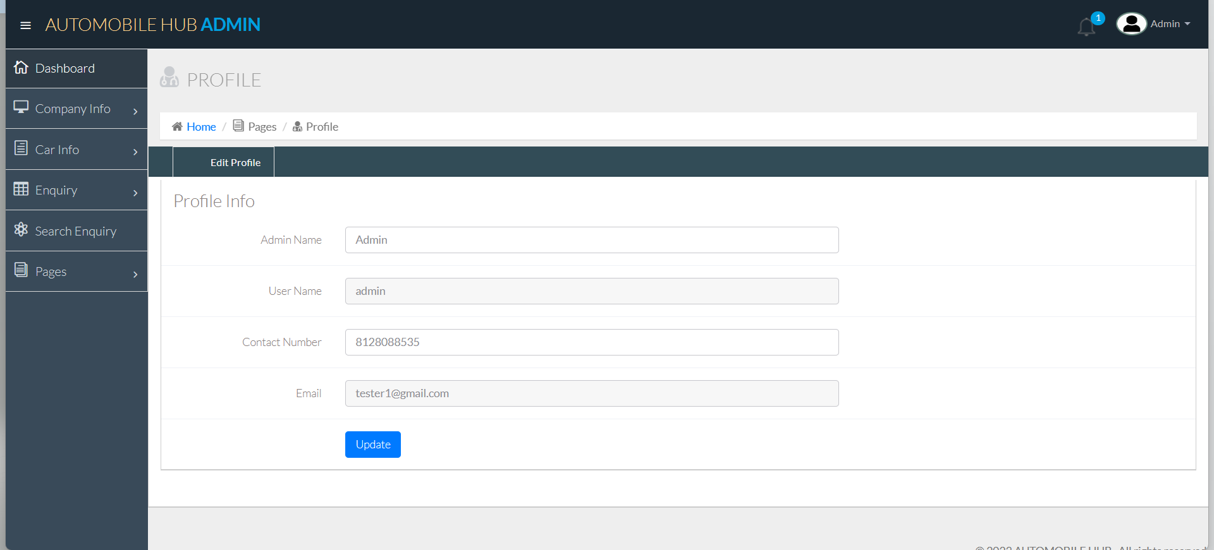
Admin profile:

Slide 56
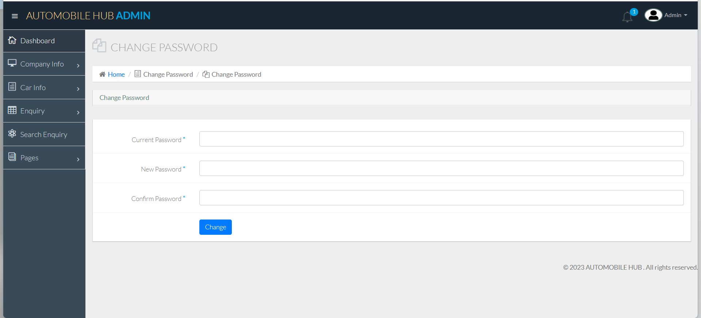
Admin Change password:

Slide 57
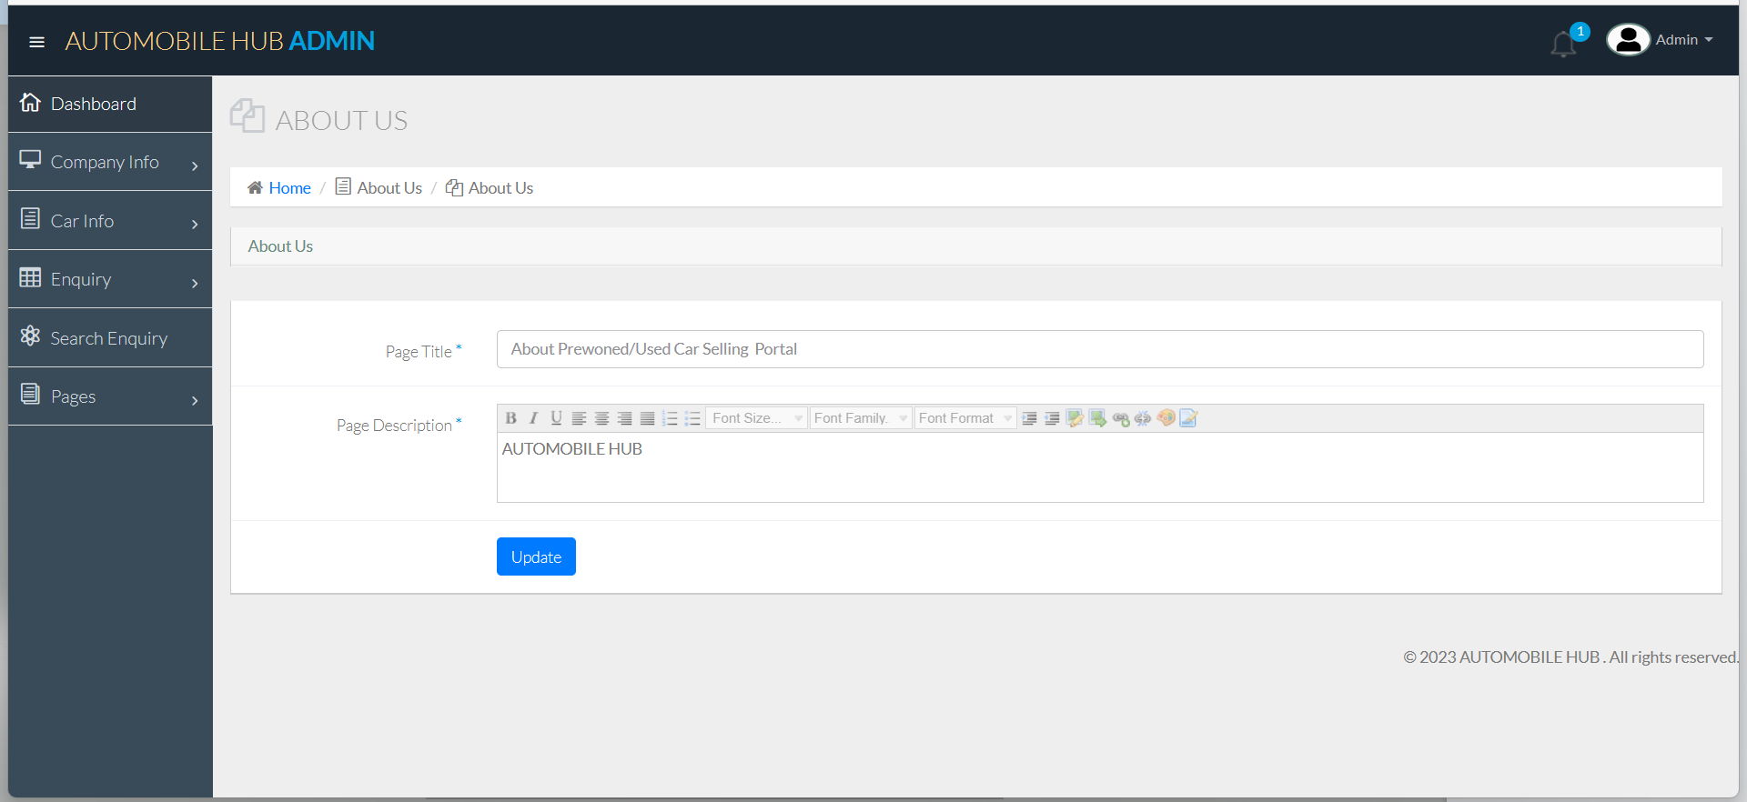
Admin About us:

Slide 58
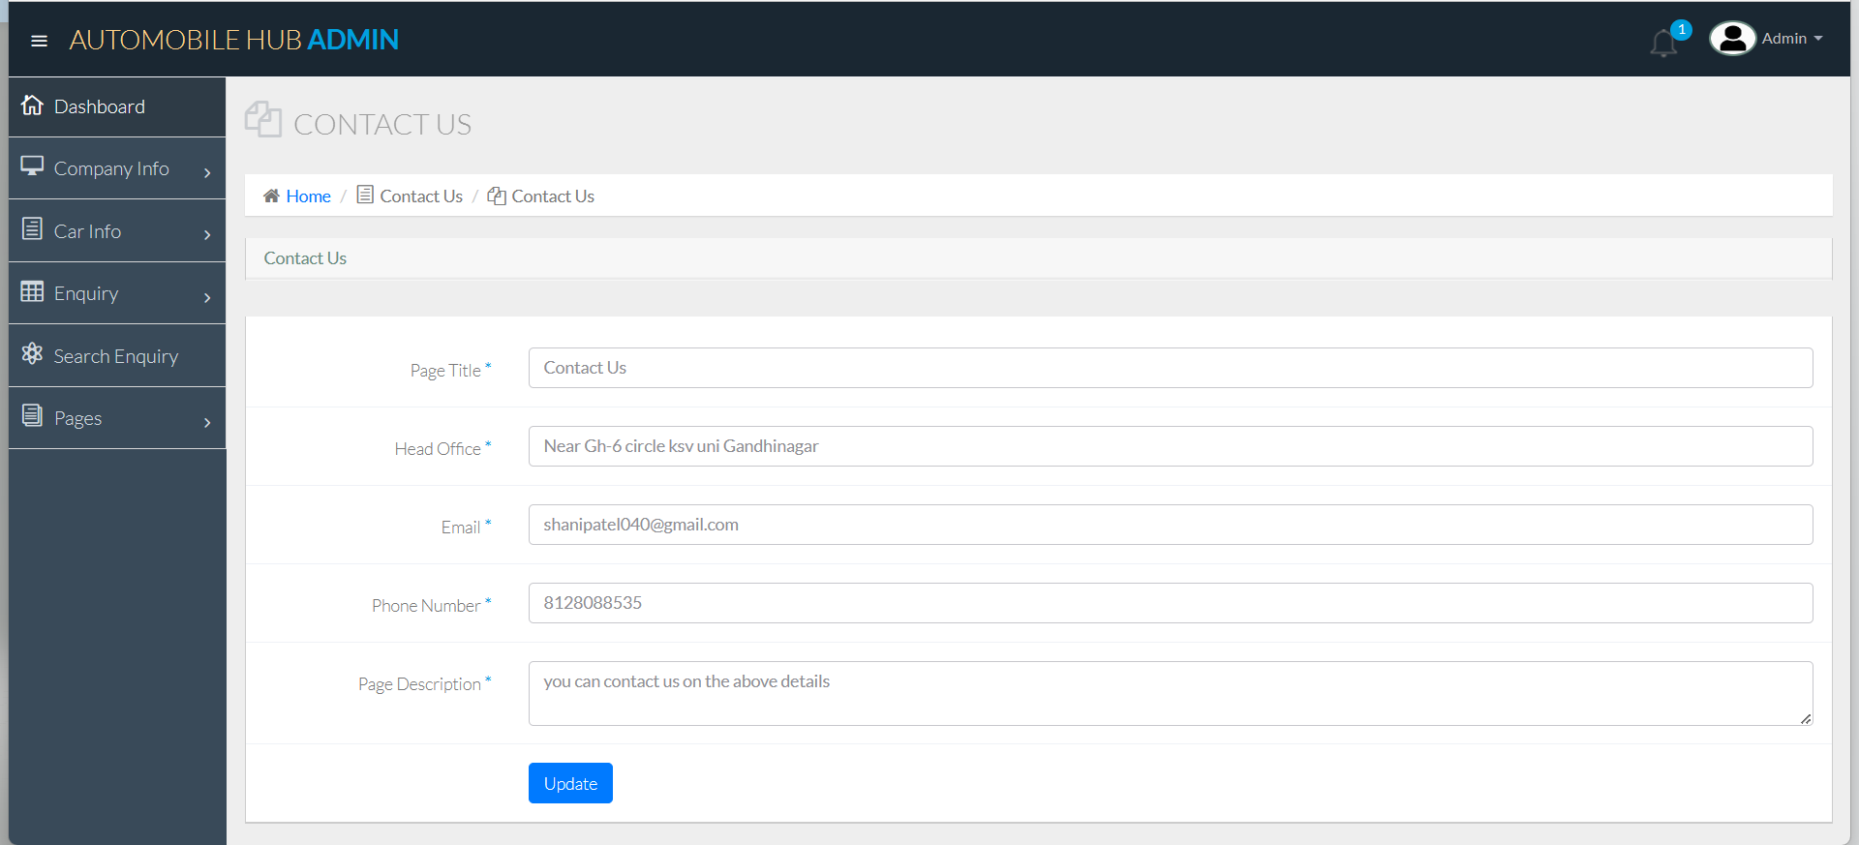
Admin contact us:

Slide 59
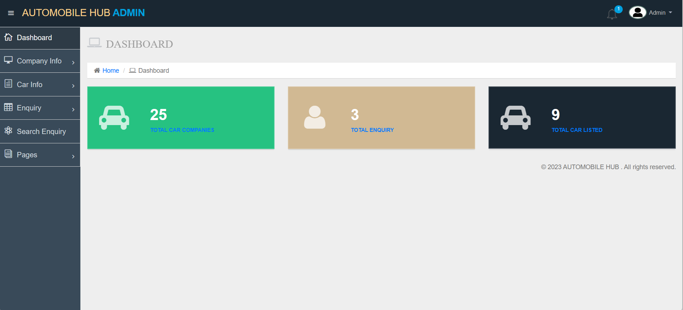
SYSTEM REPORTS Admin dashboard:

Slide 60
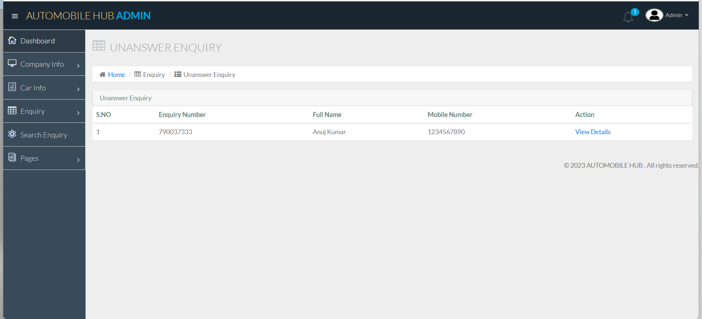
Admin contact us:

Slide 61
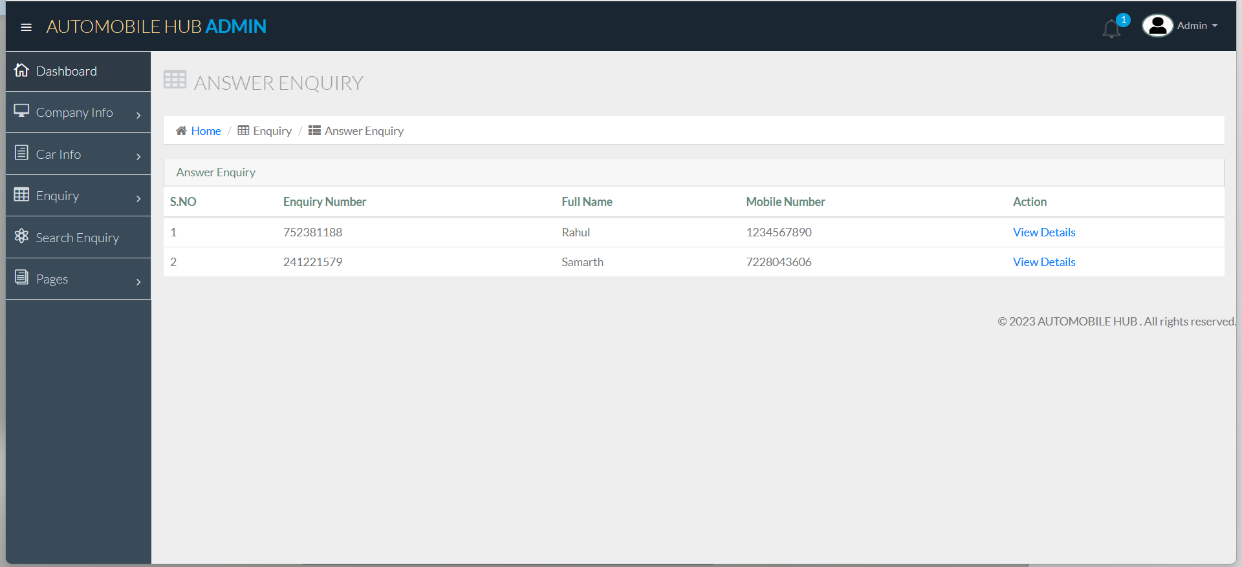
Answer enquiry:

Slide 62
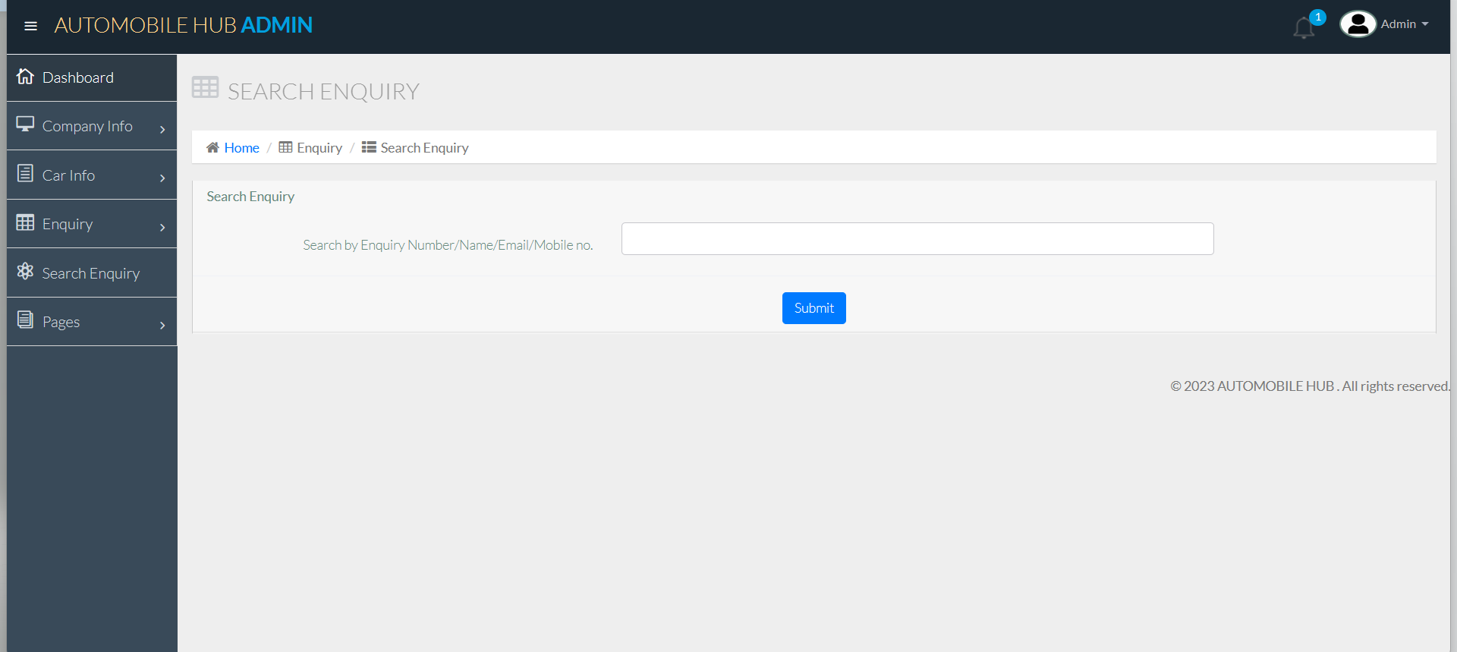
Search enquiry:

Slide 63
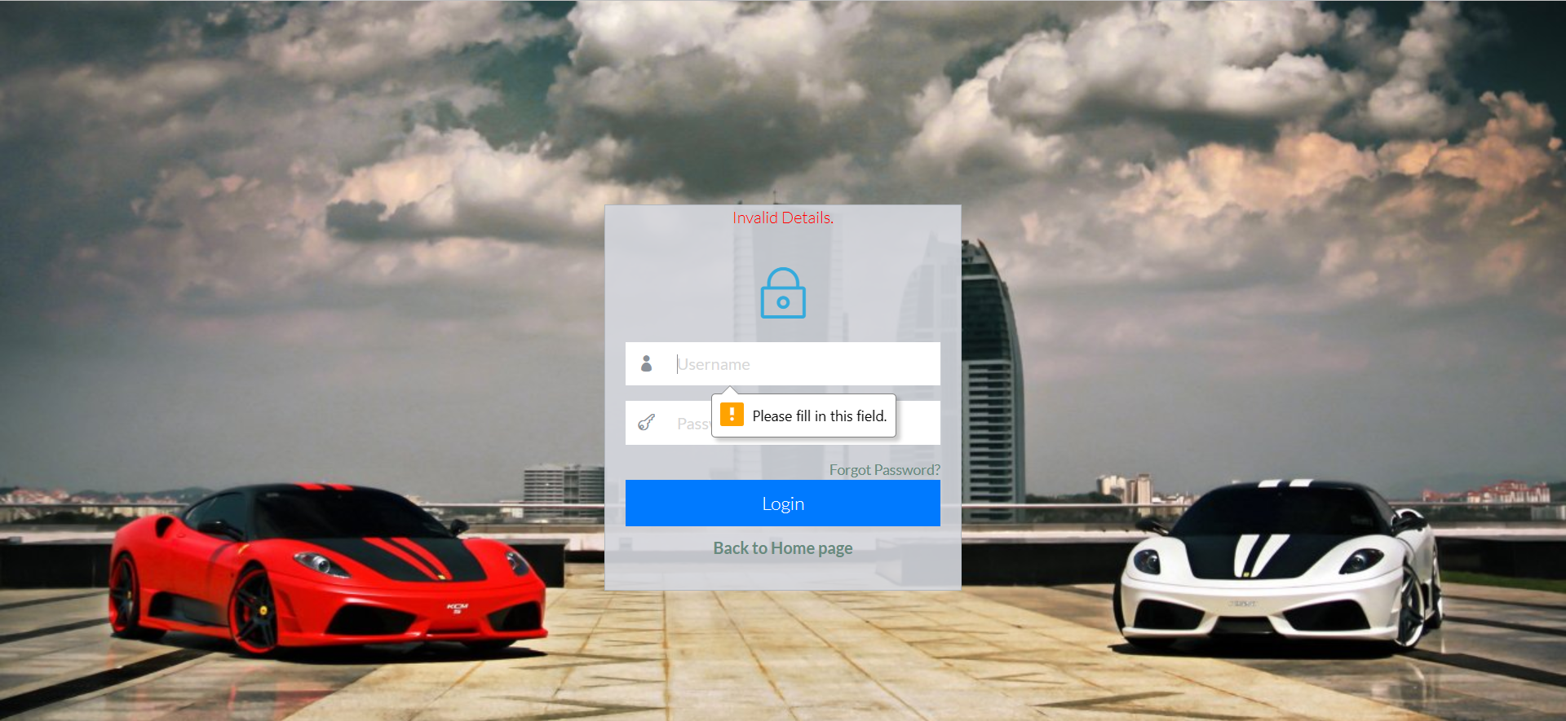
SYSTEM VALIDATIONS: Admin log in validation:

Slide 64
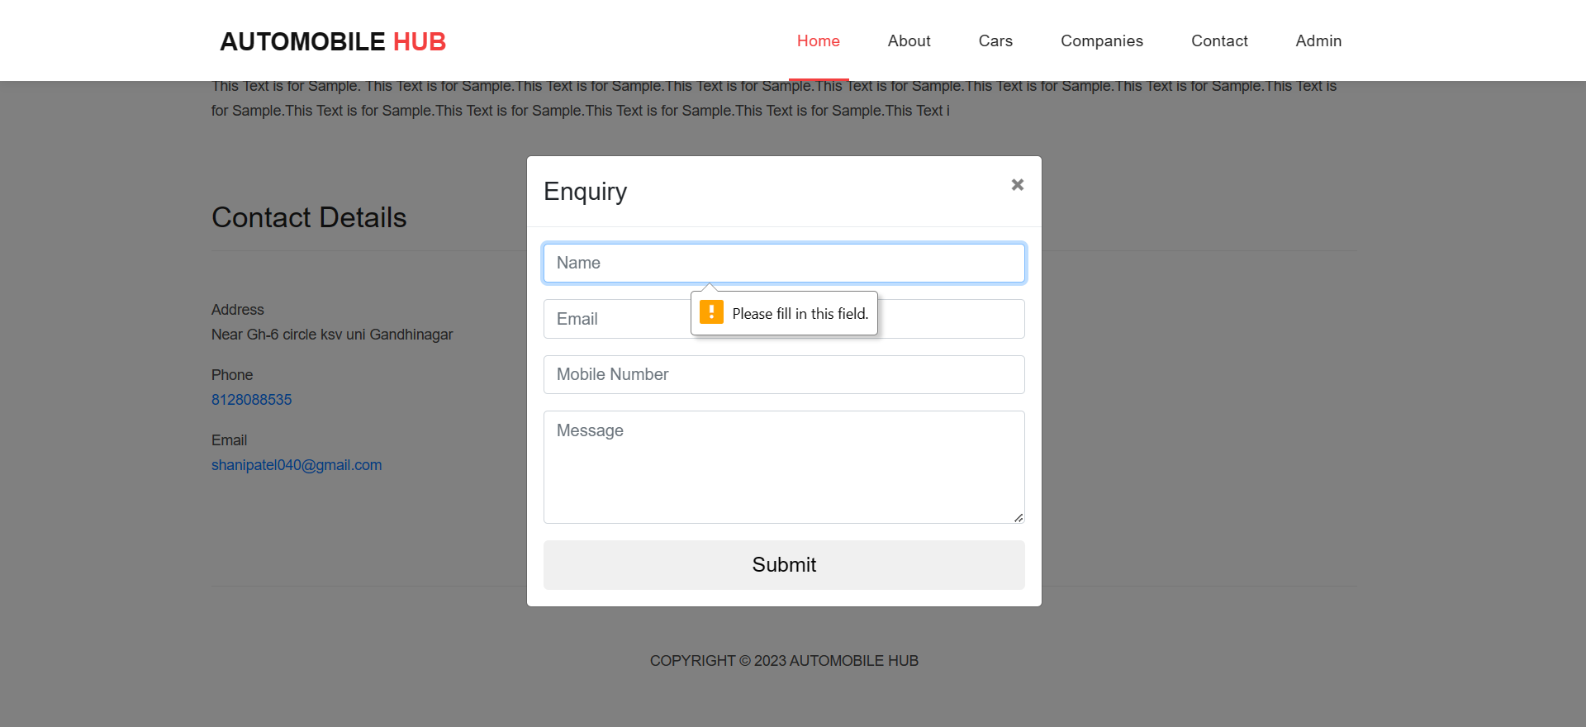
Enquiry validation:

